Slide 1

Differences in the complexity of micropore and macropore-associated dissolved organic matter and implications for C persistence in soils
A. Peyton Smith, Sarah Fansler, malak tfaily and Vanessa bailey
Notes:
Identifying the composition and biodegradability of soluble organic matter (OM) located in physically protected and unprotected pore spaces is important to our overall understanding of soil C persistence and predictions of greenhouse gas fluxes. To differentiate these physical, chemical, and biological controls on OM persistence in soil, we sought to i) characterize soluble OM from large, unprotected pore domains and from fine (thus occluded) pore domains, and ii) determine the mineralization potential of these two OM fractions. Soil pore water was extracted from soil cores sampled from the Disney Wilderness Preserve, FL using different suction strengths (-15, and -150 mb) representing water held in pores of different sizes (~ 150 and 10 μm diameters). To determine the biodegradability of the extracted OM, we used it as growth substrates for select cellulolytic bacteria and fungi (Streptomyces cellulosae, Cellvibrio japonicus, and wildtype Trichoderma reesei) in a short-term incubation. Fourier transform ion cyclotron resonance (FT-ICR) mass spectrometry was used to describe microbially-mediated transformations in the quantity and quality of carbon compounds.
Preliminary analyses show that soluble OM from micropores contained relatively more tannins and condensed hydrocarbons compared to macropore-associated DOM, which was composed of relatively more proteins and lipids. During the incubation more CO₂ was evolved from the microbes growing in the more complex micropore-associated water than from those growing in the macropore-associate water. Following incubation, we observed that the macropore-associate soluble OM became enriched in lignin, tannins and condensed hydrocarbons compared to the macropore-associated DOM, which became depleted in tannins. Our results show that the soluble OM located in protected pore domains, while chemically more complex, was more readily decomposed than the simpler macropore-associated soluble OM. This suggests that if mobilized, OM originally located in physically protected pore domains may have a greater contribution to greenhouse gas production that previously perceived.

Slide 2
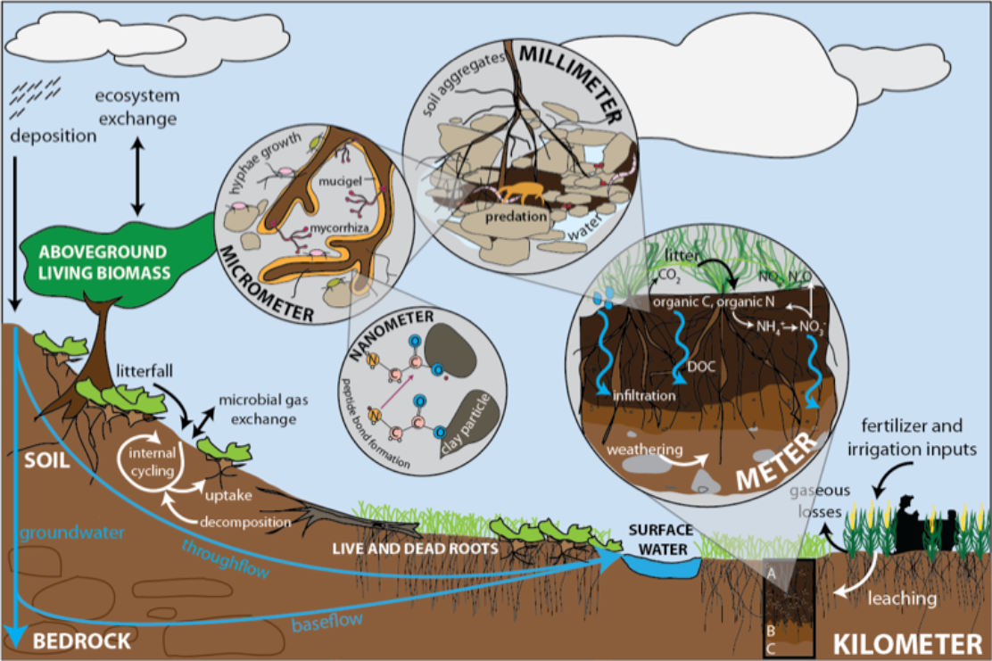
Soluble organic matter An Important source of C in soils
Microbial metabolic uptake dependent on aqueous environment
Prerequisite for solid phase organic matter (OM) decomposition
Considered labile, or readily available substrate
Important for our understanding of pathway of C in soils
Paul, 2014
Notes:
Basically all microbial uptake mechanisms require water – so in essence, “solubility is a prerequisite for diffusion of substrates through microbial cellular membrane - - Degradation of solid phase OM or large molecule C occurs only after dissolution or hydrolysis or by exoenzymes.” Marschner and Kalbitz 2003. Litter decomposition and CO₂ flux is often correlated with amount of soluble C – especially in initial stages of decomposition.
(1) Dissolved OM, or forms of water-soluble C, are considered the most bioavailable fraction of SOM.
(2) Because of its affiliation to water, it is often considered to be the most bioavailable substrate in soils.
Furthermore, water-soluble C is important because it is how C is transported throughout the soil profile and across the landscape (links the terrestrial C cycle to the aquatic one).
So, overall water-soluble OM is a key component in the global C cycle.
Decomposability – dependent on chemistry and availability of C. Water-solu
1) Properties of soluble C determine the biodegradation potential (propoteries suchs as

Slide 3
Mechanistic controls on
Soluble OM turnover unclear
Microbiome
functional potential
Biological
Molecular Composition
lability vs stability
Physical
Chemical
Location in Soil Matrix
protected vs unprotected
Notes:
And yet despite it’s importance in the global C cycle, how DOM is mineralized at the fine scale or on a mechanistic level remains uncertain. And as I mentioned, while soluble OM is considered the most available and labile substrate in soils, soluble OM is actually composed of a variety of compounds that range in labilty and availability.
We know that the properties of soluble OM play an important role in its turnover – more specifically there are two main factors that research has identified as important in controlling soluble OM mineralization :
The composition, 2) if the substrate freely available →: making up the concepts of biodegrad and bioavail. What makes it difficult to determine these factors is the spatially and chemical complexity and heterogeneity of the soil environment. Not the mention the way we analyze soils in the laboratory. However, looking at these concepts or the properties of DOM in the construct of the soil pore network is one way to get to the fine-scale and mechanistic controls over OM cycling in soils. As soluble C is transported through the soil pore network, we decided to investigate the composition and degradative potential of soluble C at the pore-scale.
Competing theories – historical hypothesis of C stabilization focusing on the concept of molecular complexity, and a more recent competing theory that soil architecture, pore structure, pore connectivity (physical protection rather than chemical protection) has a greater influence over C turnover.
Competing theories – historical hypothesis of C stabilization focusing on the concept of molecular complexity, and a more recent competing theory that soil architexture, pore structure, pore connectivity (physical protection rather than chemical protection) has a greater influence over C turnover.

Slide 4
Pore-scale investigation of soluble C
Black: void space Purple: solid Yellow: edge pixels
Axes are in pixels, 1 pixel=0.7 microns
Identifying the composition and degradation potential of soluble C throughout the soil pore network offers insight into mechanistic understanding of C loss and persistence in soils.
Bailey et al 2014
Notes:
-argue that in order to tackle this task is to take it down to the pore-scale – view (it) C through the lens at which these interactions take place – see what the microbe sees.

Slide 5
Pore-scale investigation of soluble C
Objectives:
Characterize molecular composition of soluble OM, and
Determine the decomposition potential of soluble OM,
In large, unprotected pore domains and from fine pore domains
Biological
Physical
Chemical
Notes:
“Evaluating the changes in composition of OM during degradation offer deeper insights into mechanisms and controlling factors of decomposition” such as preferential degradation and OM stabilization (Kalbitz et al. 2003),
Hypoth- carbohydrates decrease to preferential degradation or increase as a result of microbial synthesis.
Volk (1997) and Amon et al. (2001) diss carbnos and amino acids are preferentially utilized by microbes.

Slide 6
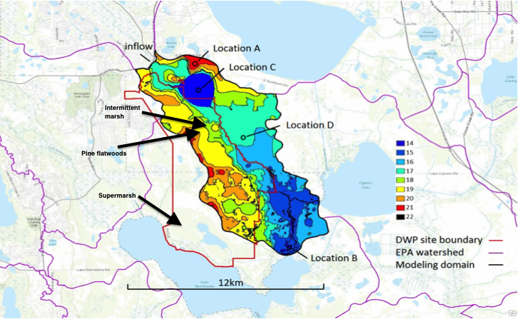
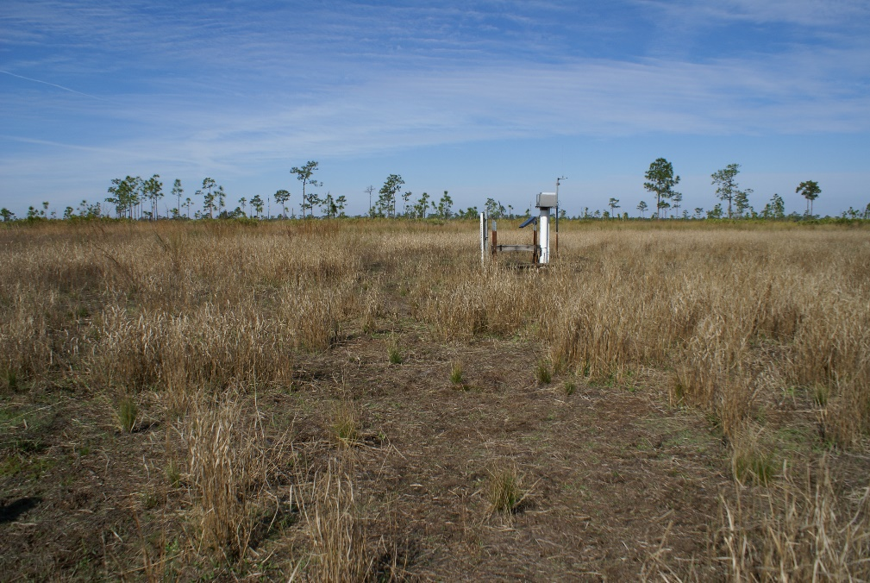
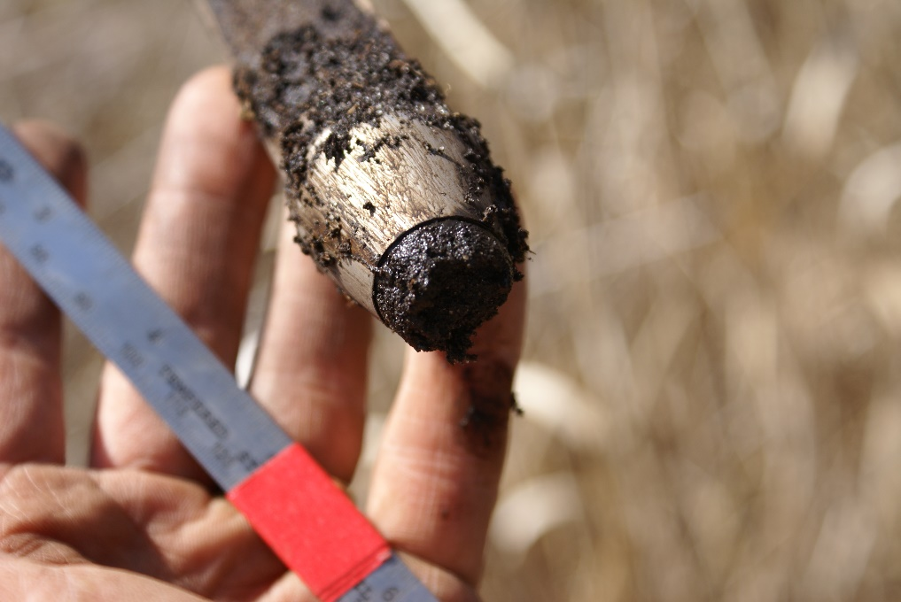




Yes, there is soil in Florida!
Intact Soil Cores - collected from DWP, Florida
Three depths: 0-30, 30-60 and 60-90 cm
Three transect locations: dry, intermittently wet, very wet
Pine Flatwoods (dry)
Disney Wilderness Preserve
Super Marsh (wet)
Notes:
How did we do this? First, I want to mention where these soils come from: The Disney Wilderness Reserve in Florida. To the untrained eye it may look like beach sand, but it is a true soil (list taxonomy). But yes, these soils are dominated by sandy textures. Why DWP soils? This is part of a much larger research project investigating pore-scale soil C dynamics, under shifting hydrologic regimes at the landscape scale. And the water Water dynamics in this system, particularly water table rise and fall, appear to be a strong control on the emissions of C-gases and the persistence of soil organic matter in these soils.
More importantly, I want to stress that all the data you will see in this presentation is extracted from intact cores. This is very important. When we study the solid phase OM in aggregates, it is relatively we easy to retain aggregate structure from the field to the lab – THIS IS NOT SO when it comes to the void space – to the pores!

Slide 7
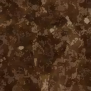
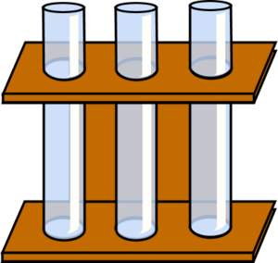
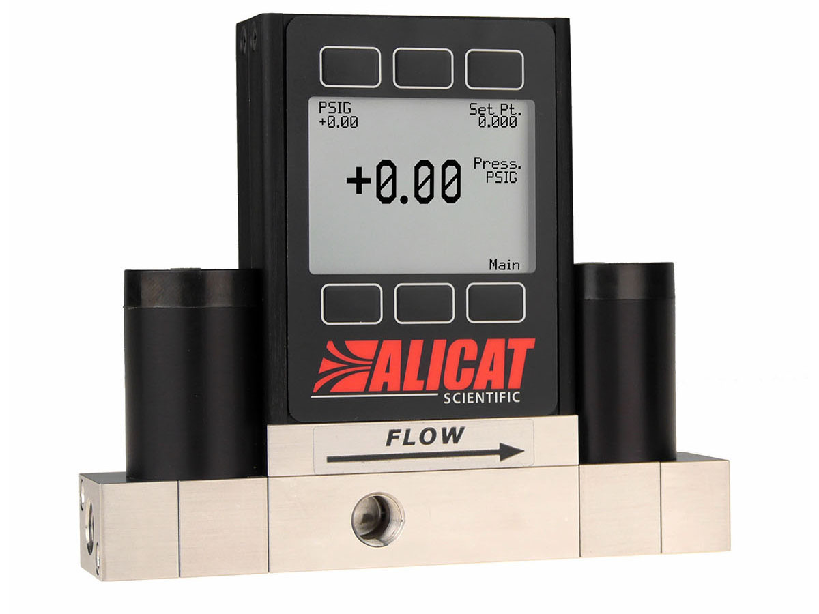
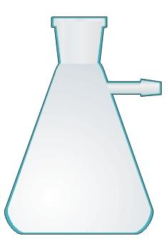
Pore water fractions collected at different tensions
Soil Pore Water – extracted at 3 differed tensions representing different pore size domains
Sequentially extracted, smaller vacuum suction (larger pores) first
Macropores
150 μm diameter
-15 mb tension
Micropores
10 μm diameter
-150 mb tension
Very Fine Micropores
3 μm diameter
-500 mb tension
intact soil core
ceramic pore plate
programmable vacuum suction pressure
Notes:
We separated these pore water fractions using different suction pressures that represented pores at different pore size domains. Today I will focus on three main fractions – a macropore fraction which we are defining as coming from pores approximately 150 microns in diameter. I realize that most of us are familiar with defined aggregate size classes (macro versus microaggregate), and truthfully pore size classes are not as well defined. But for this presentation we are defining coarse pores (approx 150 microns in diameter) as macropores and fine pores approx 10 microns are micropores, and a very very fine pore size class approx 3 microns in diameter as very fine micropores.

Slide 8
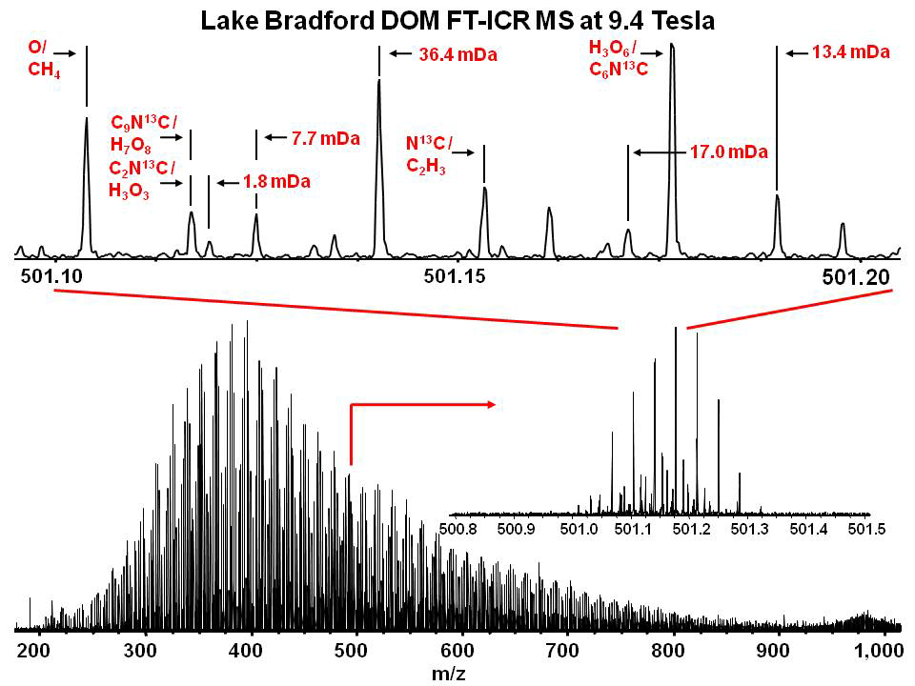
High resolution molecular characterization of OM
Electrospray ionization (ESI) coupled with Fourier transform ion cyclotron resonance mass spectrometry (FT-ICR MS) has mass resolving power (>1M) and mass measurement accuracy (<1 ppm).
Negative-Ion electrospray Ionization
FT-ICR MS at 12 Tesla
Suwannee River Fulvic Acid (SRFA)
10,000 peaks > S/N=7 (200 < m/z < 1000)
m/Δm_{50%} > 1000,000 at m/z 500
Notes:
Electrospray ionization (ESI) coupled with Fourier transform ion cyclotron resonance mass spectrometry (FT-ICR MS) offers unparalleled mass resolving power (>1M) and mass measurement accuracy (<1 ppm). Identify ionic mass-to-charge ratios from the cyclotron frequency of the ions. It has a very narrow peak width allows you to detect different ions with very similar mass-to-charge (m/z) ratios. It has become a prevailing method to assign molecular formulae to thousands of molecules in natural organic matter. In this study, FT-ICR was used to characterize C chemistry from the pore water following extraction.

Slide 9
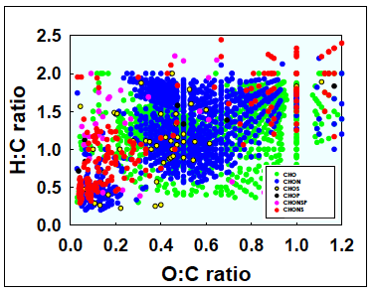
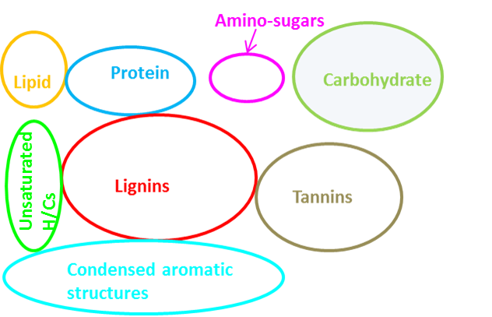
High resolution molecular characterization of OM
Compound identification via Van Krevelen diagrams elemental ratio plots
Notes:
Using the H/C and O/C ratios,
CHO aldehydes, carbohydrates, some lipids,
CHON - proteins

Slide 10
Pore-scale investigation of soluble C
Objectives:
Characterize molecular composition of soluble OM, and
Determine the decomposition potential of soluble OM,
In large, unprotected pore domains and from fine pore domains
Biological
Physical
Chemical
Notes:
“Evaluating the changes in composition of OM during degradation offer deeper insights into mechanisms and controlling factors of decomposition” such as preferential degradation and OM stabilization (Kalbitz et al. 2003),
Hypoth- carbohydrates decrease to preferential degradation or increase as a result of microbial synthesis.
Volk (1997) and Amon et al. (2001) diss carbnos and amino acids are preferentially utilized by microbes.

Slide 11
Location in soil pore matrix
alters OM composition
Notes:
Non-metric multidimensional scaling – ordination analysis.

Slide 12
Greater OM complexity in fine pore domains
Notes:
Non-metric multidimensional scaling – ordination analysis.

Slide 13
Pore-scale investigation of soluble C
Objectives:
Characterize molecular composition of soluble OM, and
Determine the decomposition potential of soluble OM,
In large, unprotected pore domains and from fine pore domains
Biological
Physical
Chemical
Notes:
“Evaluating the changes in composition of OM during degradation offer deeper insights into mechanisms and controlling factors of decomposition” such as preferential degradation and OM stabilization (Kalbitz et al. 2003),
Hypoth- carbohydrates decrease to preferential degradation or increase as a result of microbial synthesis.
Volk (1997) and Amon et al. (2001) diss carbnos and amino acids are preferentially utilized by microbes.

Slide 14
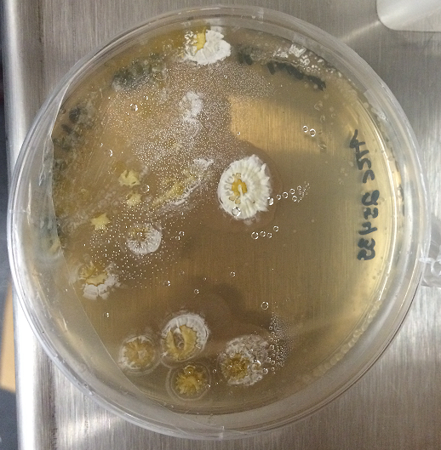
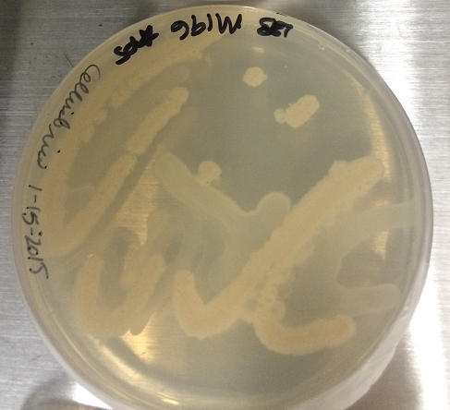
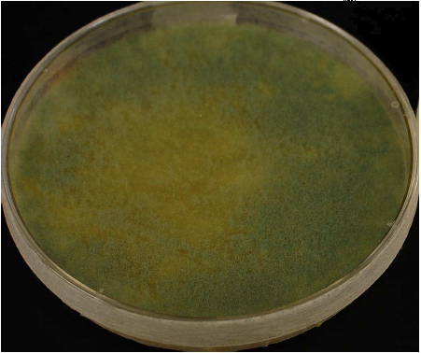
Incubation of inoculated soil pore water
Streptomyces cellulosae
(ATCC® 25439™) is a Gram-positive actinobacteria isolated from soil.
Biodegradation Potential
Filter-sterilized pore water was used as a growth substrate in pure cultures in a short-term incubation (8 days)
CO₂ measured throughout incubation,
C content (DOC/DON) and C profile (FTICR) pre- and post-incubation.
Cellvibrio japonicus
(DSMZ 16018) is a Gram-negative bacteria isolated from soil.
Trichoderma reseei
(QM6a) is a wild-type fungi from the phylum Ascomycota.

Slide 15
Incubation of inoculated soil pore water
Streptomyces cellulosae
(ATCC® 25439™) is a Gram-positive actinobacteria isolated from soil.
Macropores
150 μm diameter
-15 mb tension
Micropores
10 μm diameter
-150 mb tension
Very Fine Micropores
3 μm diameter
-500 mb tension
Cellvibrio japonicus
(DSMZ 16018) is a Gram-negative bacteria isolated from soil.
Trichoderma reseei
(QM6a) is a wild-type fungi from the phylum Ascomycota.
Notes:
Intact soil cores from three continuous depths (0-30, 30-60 and 60-90 cm) at three transect locations (dry, intermittently wet, and wet) were collected from the Disney Wilderness Preserve, FL (DWP). Soil pore water was extracted at different water tensions (15, 150 and 500 mb) representing water held in pores of different sizes (approximately 150-, 10- and 3 μm pore diameters).
Water dynamics in this system, particularly water table rise and fall, appear to be a strong control on the emissions of C-gases and the persistence of soil organic matter in these soils. Soils at DWP are dominated by sandy textures, and depending local topographic position, show moderate to high levels of SOM accumulation at the surface.
Electrospray ionization (ESI) coupled with Fourier transform ion cyclotron resonance mass spectrometry (FT-ICR MS) offers unparalleled mass resolving power (>1M) and mass measurement accuracy (<1 ppm). It has become a prevailing method to assign molecular formulae to thousands of molecules in natural organic matter. In this study, FT-ICR was used to characterize C chemistry from the pore water following extraction.

Slide 16
OM composition differs by microbe, not pore size
Amino Sugars
Carbohydrates
Unsaturated
Hydrocarbons
Tannins
Condensed Hydrocarbons
Notes:
Condensed hydrocarbons make up 89% of the variation seen along axis 1
Proteins, lipids and tannins, explain 65-70% of the variation
Amino sugars, lignin correlate with axis 2.

Slide 17
Lipids relatively depleted Lignin relatively enriched
Notes:
Unassigned peaks – highly correlated with ordination of identified microbial transformations. In nearly all of the identified transformations that had a significant treatment effect, trichoderma-inoculated samplepore water showed greater rates ‘activity’ of contained relatively more microbial transformation

Slide 18
Notes:
Unassigned peaks – highly correlated with ordination of identified microbial transformations. In nearly all of the identified transformations that had a significant treatment effect, trichoderma-inoculated samplepore water showed greater rates ‘activity’ of contained relatively more microbial transformation

Slide 19
Lignin, carbohydrates, amino sugars relatively enriched
Notes:
Unassigned peaks – highly correlated with ordination of identified microbial transformations. In nearly all of the identified transformations that had a significant treatment effect, trichoderma-inoculated samplepore water showed greater rates ‘activity’ of contained relatively more microbial transformation

Slide 20
Summary: Microorganisms influence transformations, not pore size
More pre and post-incubation effects emerge when analyzing the inoculants separately
Pure culture batches have different effects on changes in the composition of C
Microorganisms show different functional potentials in soluble OM decomposition
Still no effect of pore size domain on changes in the composition of C
Notes:
Unassigned peaks – highly correlated with ordination of identified microbial transformations. In nearly all of the identified transformations that had a significant treatment effect, trichoderma-inoculated samplepore water showed greater rates ‘activity’ of contained relatively more microbial transformation
Different Inoculants have different effects on changes in C profile
More pre/post effects emerge when analyzing inoculants separately
Still no effect of pore size

Slide 21
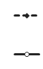
More C respired from micropores relative to macropores
Fine Pores (10 μm diameter)
Coarse Pores (150 μm diameter)
Streptomyces
Cellvibrio
Trichoderma
Trichoderma greater respiration of macro and micropore C

Slide 22
Summary: no effect of the molecular composition of C on mineralization potential
Micropore and Macropore associated soluble OM differs in composition and biodegradability.
Despite increased OM complexity in fine pore domains, it may have a greater degradation potential than macropore-associated soluble OM.
If mobilized, OM originally protected may lead to greater CO₂ emissions than previously predicted.
Notes:
This suggests that if mobilized, OM originally located in physically protected pore domains may have a greater contribution to greenhouse gas production that previously perceived.

Slide 23
Physical and biological mechanisms
influence C use and loss
Functional potential of microorganisms altered transformations and C flux
Location in pore size domains controls bioavailability
Molecular composition did not influence mineralization
Biological
Physical
Chemical
Notes:
“Evaluating the changes in composition of OM during degradation offer deeper insights into mechanisms and controlling factors of decomposition” such as preferential degradation and OM stabilization (Kalbitz et al. 2003),
Hypoth- carbohydrates decrease to preferential degradation or increase as a result of microbial synthesis.
Volk (1997) and Amon et al. (2001) diss carbnos and amino acids are preferentially utilized by microbes.

Slide 24


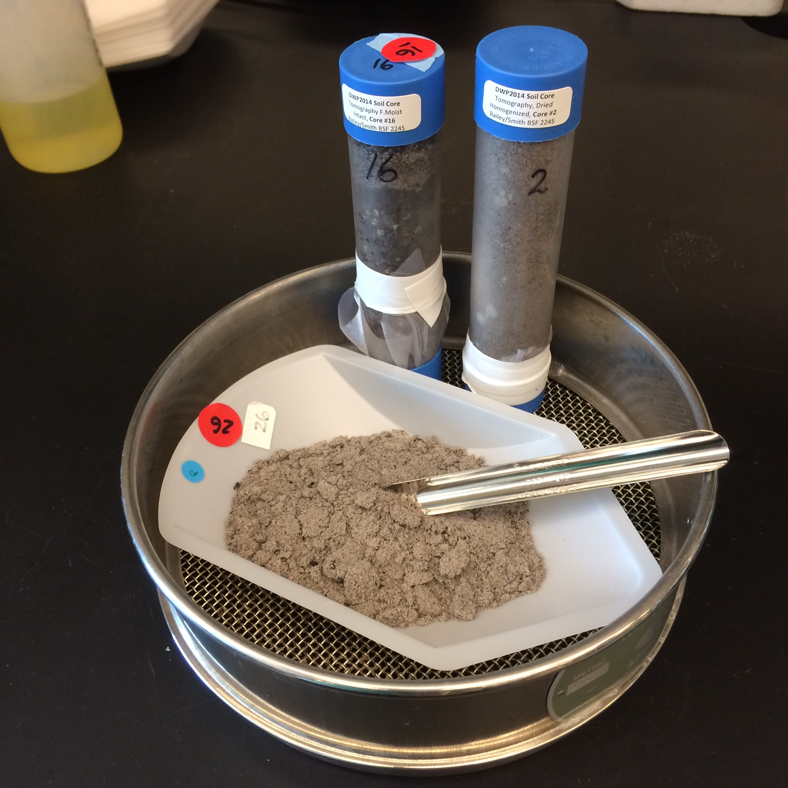

acknowledgements
DOE
Office of Biological and Environmental Research (BER),
Terrestrial Ecosystem Science Program.
Environmental Molecular Science Laboratory
Nancy Hess
Malak Tfaily (co-author)
Scott Graham and Ross Hinkle (University of Central Florida)
Bailey Lab
Eric Bottos, Taniya Roy-Chowdry, Sarah Fansler (co-author),
and Kathe Todd-Brown
Future Soil Ecologists
contact: peyton.smith@pnnl.gov @apeyton_smith
Notes:
ACKNOWLEDGEMENTS This research was supported by the DOE Office of Biological and Environmental Research (BER), as part of BER’s Terrestrial Ecosystem Science Program. It is partially performed in the Environmental Molecular Science Laboratory, a national scientific user facility sponsored by the DOE's Office of Biological and Environmental Research and located at PNNL. We also wish to thank Scott Graham (University of Central Florida, UCF) and Ross Hinkle (UCF) for their assistance at DWP, as well as Nancy Hess and Malak Tfaily (EMSL) for their assistance at EMSL and with FT-ICR.

Slide 25
Shifts in complexity of OM after inoculation
Lipids
Lignin
Carbohydrates
Tannins
Change in relative abundance [Pre (%) – Post (%)]
Relative depletion of lipids
Relative enrichment of carbohydrates, lignin and tannins

Slide 26
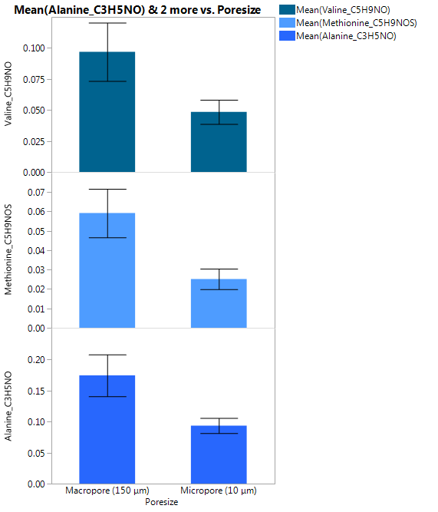
Greater microbial cycling of amino acids in coarse pore size domains
Microbial Metabolic Transformations in OM
Valine
Methionine
Alanine
Coarse Pores
(150 μm diameter)
Fine Pores
(10 μm diameter)

Slide 27
